Slide 1
Sales Performance Dashboard Analysis USING POWER BI
TEAM 3
TEAM NAME : PROFIT DETECTORS

Slide 2
TEAM MEMBERS
• SHANTANU ANAND
UDAY KUMAR
TANGUTURI SAI KUMAR
HINDAVI PATIL
MUBASHEER (NOT IN CONTACT)

Slide 3
INTRODUCTION
The Sales Performance Dashboard leverages Power BI to turn complex sales data into actionable insights, providing a comprehensive view of sales and customer trends. This tool is tailored to help decision-makers understand key sales drivers and customer behaviors.
Dataset Overview:
The dataset integrates various data sources, including:
Customer Demographics: Information on customer regions, acquisition dates, and purchase frequency.
Sales Transactions: Detailed records of each sale, including order date, product sold, sale amount, and discount information.
Product Information: Data on product categories, pricing, release dates, and status (e.g., new vs. existing products).
Customer Feedback: Customer ratings and satisfaction metrics, allowing us to correlate sentiment with sales performance.

Slide 4
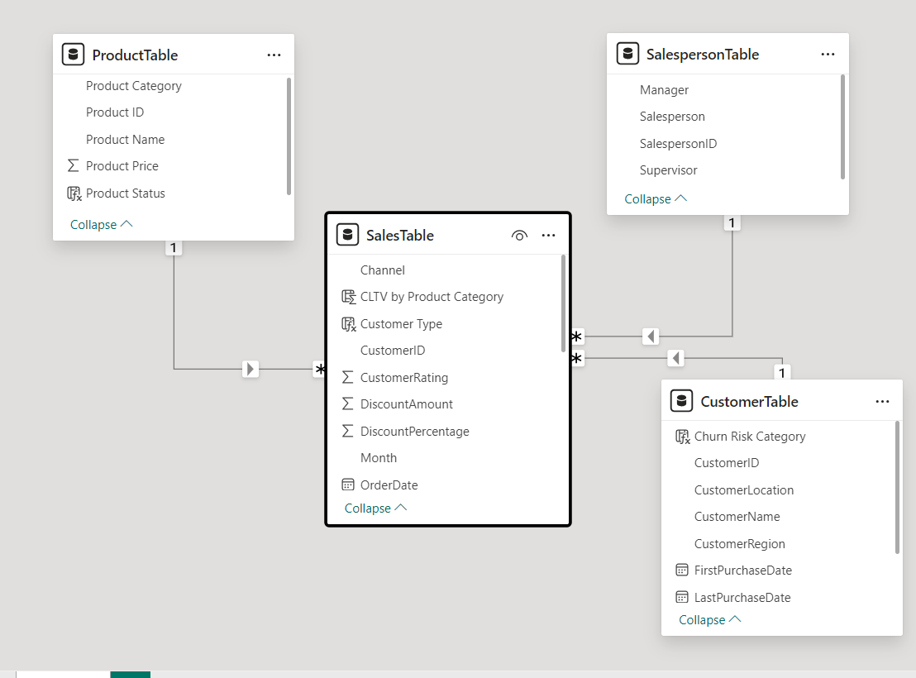
DATASET MODEL VIEW

Slide 5
PROJECT OVERVIEW
· It integrates data from multiple sources, including sales transactions, customer demographics, and product details, to provide a holistic view of sales performance.
· Key focus areas include:
Product Sales Trends: Analyze how new and existing products perform over time.
Customer Lifetime Value (CLTV): Track cumulative value generated by customers across regions and product categories.
Churn Prediction & Retention: Identify customers at risk of churning to improve retention strategies.
Customer Sentiment: Examine customer ratings and their impact on sales.
Sales by Customer Type: Compare trends between new and repeat customers.
Geo-Spatial Sales Trends: Visualize sales distribution across different regions.
· This dashboard empowers stakeholders to make data-driven decisions by providing actionable insights that drive business growth and enhance customer satisfaction.

Slide 6
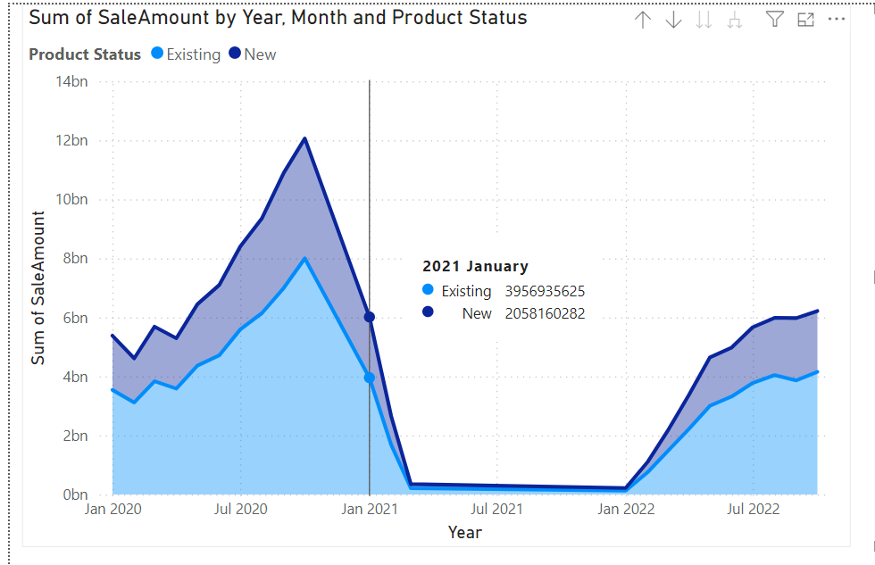
MILESTONE 2
Proposal Part 1 - Product Sales Cannibalization Analysis
Objective: Determine if new product launches affect sales of existing products within the same category.
Method: A Stacked Area Chart tracks monthly sales trends for "New" vs. "Existing" products.
Key Insight: If "Existing" product sales decline as "New" product sales increase, this indicates possible cannibalization.
Example: The chart shows fluctuations in sales, particularly during new product introductions, helping assess their impact on existing products.

Slide 7
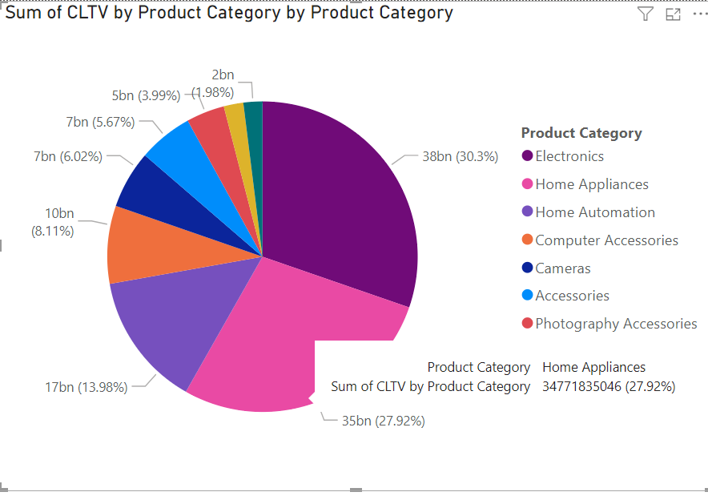
MILESTONE 2
Proposal Part 2 - Customer Lifetime Value (CLTV) Analysis
• Objective: Calculate the cumulative value each customer contributes over time by analyzing CLTV across different product categories.
• Method: A Pie Chart displays the distribution of CLTV by product category, highlighting long-term value drivers.
• Key Insight: Identify high-value product categories that generate sustained customer revenue, supporting strategic focus.
• Example: The chart shows Electronics and Home Appliances as top contributors to CLTV, helping prioritize resource allocation.

Slide 8
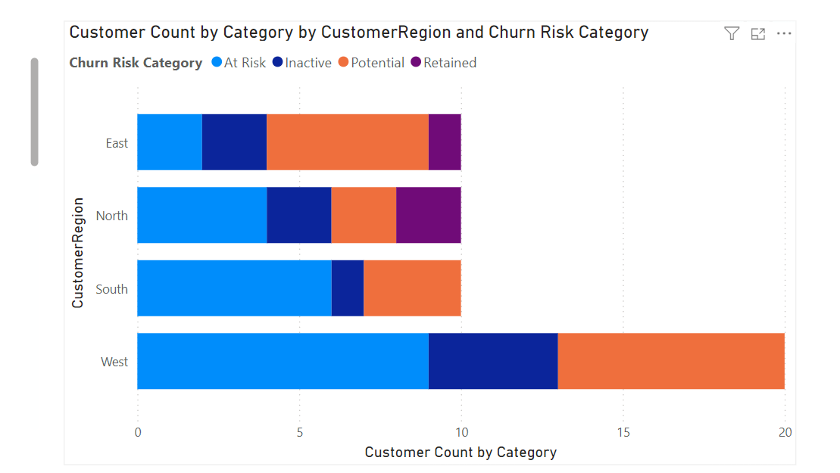
MILESTONE 2
Proposal Part 3 - Churn Prediction and Retention Insights
• Objective: Identify customers at risk of churning based on recent purchase frequency and categorize by regions.
• Method: A Stacked Bar Chart categorizes customers by churn risk level (At Risk, Inactive, Potential, Retained) across different regions.
• Key Insight: Regional churn analysis helps to understand areas with higher risk, guiding targeted retention strategies.
• Example: The chart reveals that the West region has the highest number of at-risk customers, prompting potential focus on engagement initiatives in that area.

Slide 9
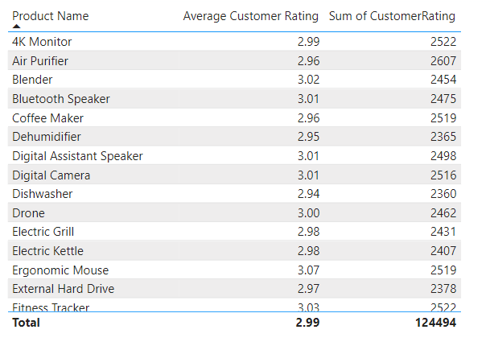
MILESTONE 2
Proposal Part 4 - Customer Sentiment Analysis:
· Objective: Examine customer satisfaction through ratings and understand its correlation with product categories and overall sales.
· Analysis:
Average customer ratings were calculated and summarized by product categories to identify high- and low-performing segments

Slide 10
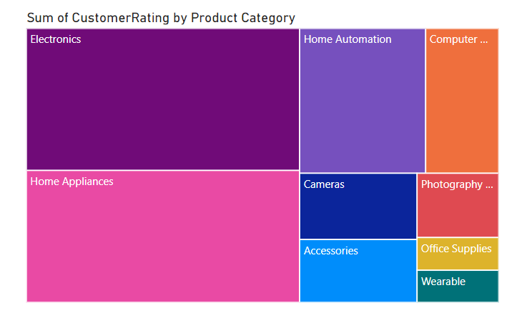
MILESTONE 2
Proposal Part 4 - Customer Sentiment Analysis:
• Tree map visualization highlights sentiment trends across product categories.
Insight:
Positive customer sentiment in key categories may drive higher sales, aiding in prioritizing product improvement efforts for lower-rated categories.

Slide 11
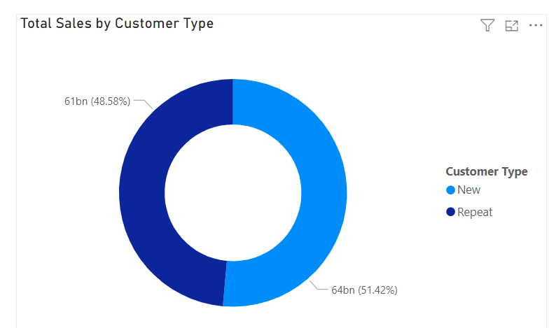
MILESTONE 2
Proposal Part 5 - New vs. Repeat Customer Sales Trends
• Objective: Differentiate sales trends between new and returning customers to analyze customer loyalty and acquisition effectiveness.
• Insights:
Shows total sales proportion contributed by new vs. repeat customers.
Identifies growth in repeat customer purchases, indicating strong customer loyalty.
Allows businesses to understand the balance between new customer acquisition and retention.
• Visualizations:
Donut Chart: Displays the proportion of total sales between new and repeat customers.

Slide 12
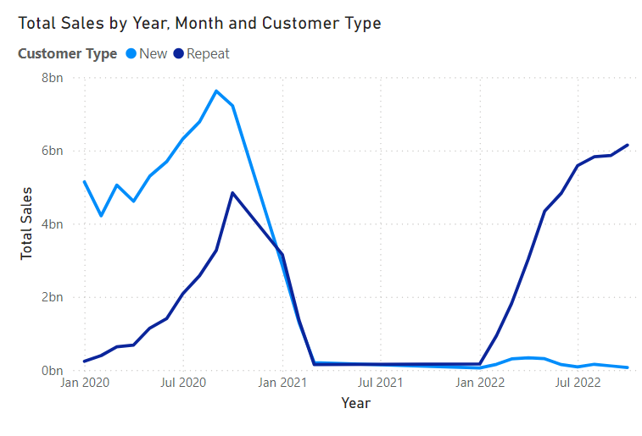
MILESTONE 2
Proposal Part 5 - New vs. Repeat Customer Sales Trends
Line Chart: Tracks monthly sales trends for both customer types over time, highlighting sales performance peaks and customer retention success.

Slide 13
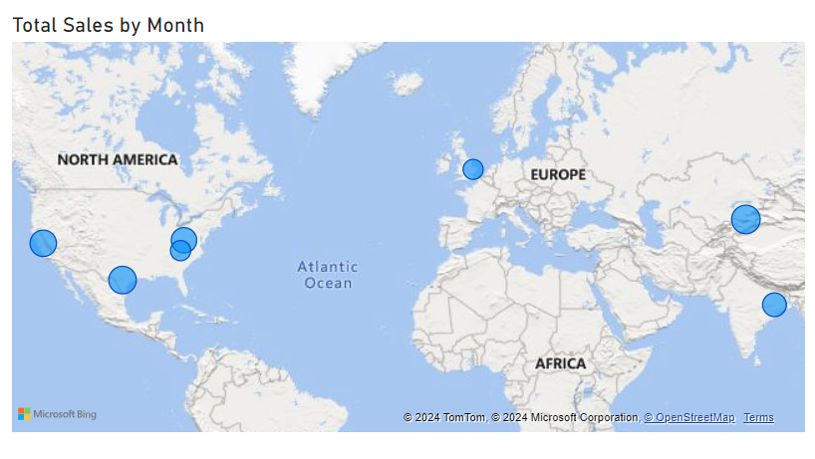
MILESTONE 2
Proposal Part 6 - Geo-Spatial Sales Trends
• Objective: Map sales distribution by customer location to identify regions with high sales potential and growth trends.
• Insights:
Visualizes total sales distribution across different global locations, providing insights into geographic performance.
Helps identify regions with significant sales contributions, enabling targeted marketing strategies.
Reveals areas of opportunity for expansion and regions needing more focus.
• Visualization:
Map Visual: Displays sales volume by geographic location with bubble size representing total sales. Allows users to observe monthly sales patterns across regions.

Slide 14
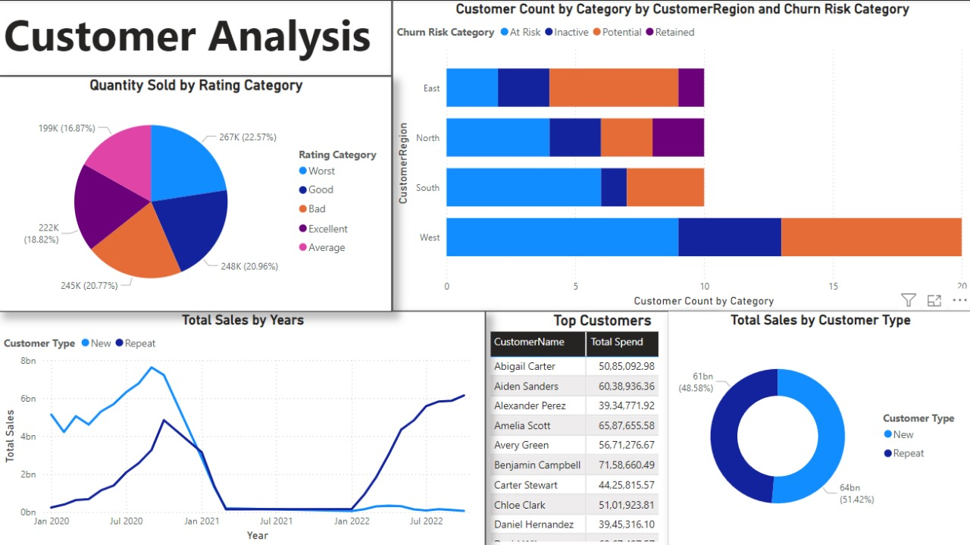
CUSTOMER ANALYSIS BASED VISUALIZATIONS

Slide 15
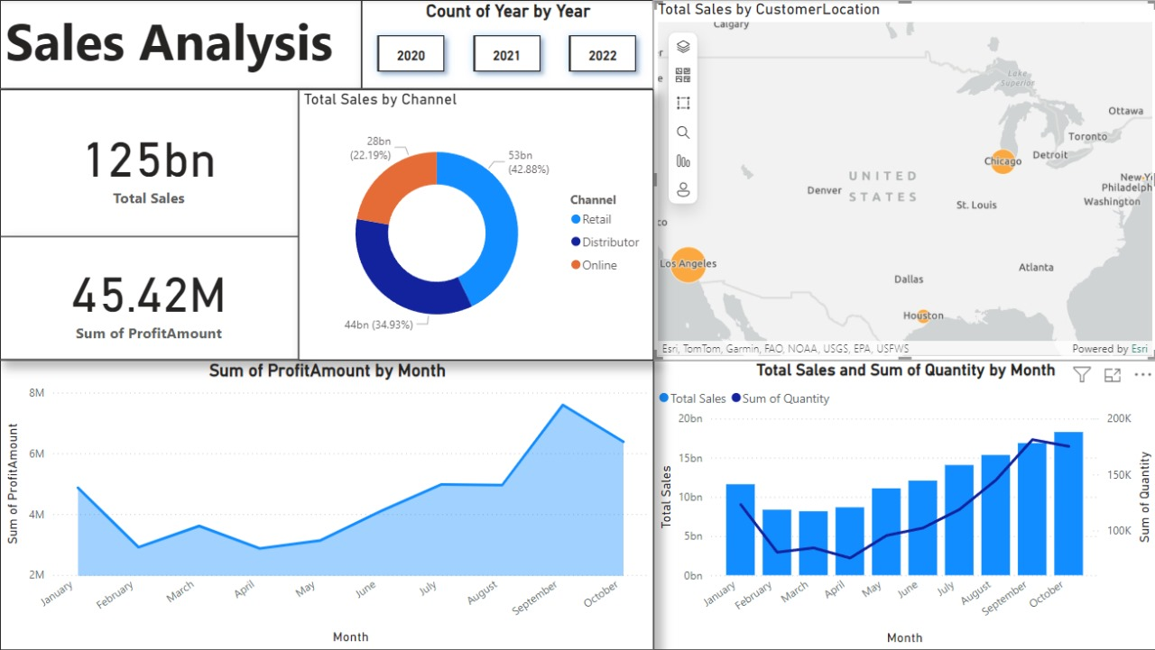
SALES ANALYSIS BASED VISUALIZATIONS

Slide 16
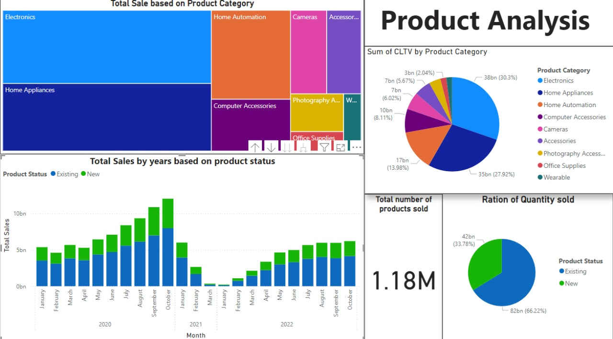
PRODUCT ANALYSIS BASED VISUALIZATIONS

Slide 17
CONCLUSION
• The Sales Performance Dashboard provides a comprehensive view of sales dynamics, customer behavior, and product trends.
• Key analyses, including CLTV, churn risk, and product sales cannibalization, offer actionable insights to drive business growth and customer retention.
• Visualizations like dual-axis charts, pie charts, and geographic mapping make complex data easily interpretable.
• This dashboard enables data-driven decision-making, supporting strategies for targeted marketing, improved customer satisfaction, and optimal resource allocation.

Slide 18
FUTURE ENHANCEMENTS
• Advanced Customer Segmentation: Divide customers into distinct segments based on behavior, demographics, or purchase patterns. This enables targeted marketing strategies and personalized sales approaches.
• Sales Forecasting and Predictive Analytics: Use historical sales data and machine learning algorithms to predict future sales trends. This helps in inventory planning, budgeting, and setting realistic sales goals.
• Marketing Campaign Impact Analysis: Measure the effectiveness of marketing campaigns by tracking their influence on sales, customer acquisition, and retention. This allows for optimization of marketing spend and strategy.

Slide 19
• Enhanced Geo-Spatial Sales Analysis: Map sales data with advanced geospatial visualizations to identify high-performing regions and uncover local trends. This insight supports regional sales strategy and resource allocation.
• Product Sales Velocity: Analyze the speed at which products sell over a certain period to identify high-demand items and adjust production or inventory levels accordingly.
• Improved Customer Lifetime Value (CLTV) Metrics: Enhance CLTV calculations by including factors like purchase frequency, average transaction value, and customer retention rate, providing a more accurate forecast of long-term profitability from each customer segment.
• Discount and Promotion Effectiveness Analysis: Analyze how discounts and promotions impact sales volume and profit margins. This helps in understanding the optimal discount levels and timing for maximizing revenue without compromising profitability.
• Customer Feedback and Sentiment Analysis Integration: Incorporate sentiment analysis on customer reviews and feedback to track customer satisfaction and identify areas for improvement. This can provide actionable insights for product enhancements and service quality.

Slide 20
THANK YOU

